Slide 1



Our Internship
Suraj Anand and Ryan Apfel
Notes:
S+R

Slide 2
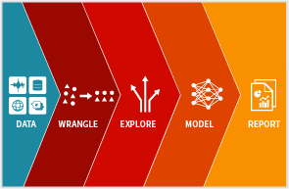

Slide 3
Data Science Overview
WHY FOR YOU:
Build tools that make the data science process easier
Explore models that have the potential to be deployed
WHY FOR US:
Learn model construction and deployment process from start to finish
Engage with KP innovation process
Notes:
S+R
OUR PROCESS:
Data preprocessing and outlier detection
Feature Engineering
Model Construction
Communication
https://www.upgrad.com/blog/a-beginners-guide-to-data-science-and-its-applications/

Slide 4
Data Preprocessing and Outlier Detection
DATA PREPROCESSING
FEATURE ENGINEERING
MODEL CONSTRUCTION
COMMUNICATION
Notes:
R

Slide 5
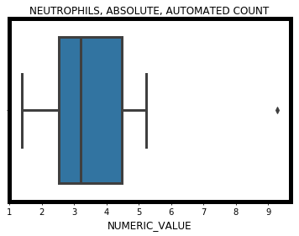
Outlier Detection Tool
WHY IT’S IMPORTANT
Outliers distort model predictions and diminish accuracy
A model is only as good as the data you provide it
POSSIBLE OUTLIER CAUSES
Data entry errors (human errors)
Measurement errors (instrument errors)
Anomalous patients (no errors)
?!?!!?
Notes:
S

Slide 6
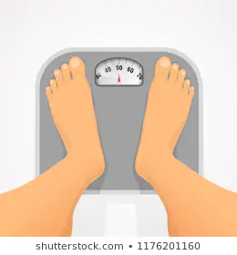
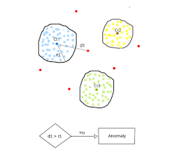
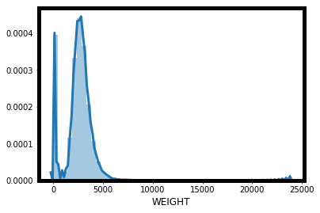
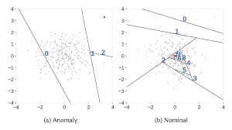
Medically Infeasible
3. PCA + KMeans
8 tons
2. Z-Score Anomaly Analysis
4. Isolation Forest
Notes:
S

Slide 7
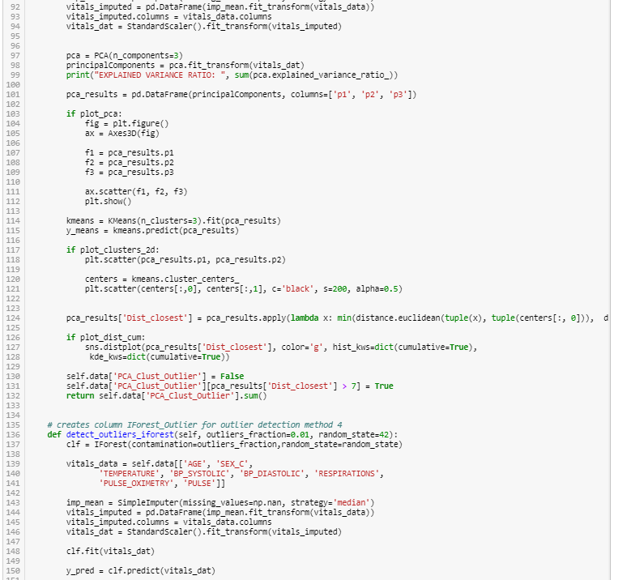
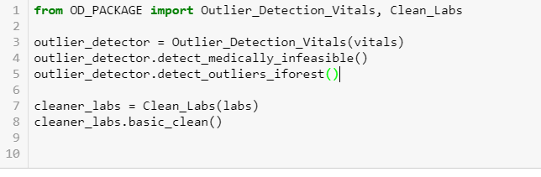
Outlier Detection Deliverable
400 Lines of Code
6 Lines of Code
WHAT WE DID:
Developed a portable package for simple use of sophisticated outlier detection and data preprocessing techniques
Notes:
R

Slide 8
Feature Engineering
DATA PREPROCESSING
FEATURE ENGINEERING
MODEL CONSTRUCTION
COMMUNICATION
Notes:
R

Slide 9
Feature Engineering
WHY WE NEED TO “ENGINEER” FEATURES
Data is like the crude oil of machine learning which means it has to be refined into features.
Without relevant features, you can’t train an accurate model, no matter how complex the machine learning algorithm.
WHAT ARE FEATURES FOR US
Diagnoses
Lab Data
Personal Info (DOB, ZIP, Race)
Notes:
R
It’s often said that “data is the fuel of machine learning.” This isn’t quite true: data is like the crude oil of machine learning which means it has to be refined into features — predictor variables — to be useful for training a model. Without relevant features, you can’t train an accurate model, no matter how complex the machine learning algorithm. The process of extracting features from a raw dataset is called feature engineering.

Slide 10
How similar are these words?
Walked
vs
Strolled
vs
Died
Notes:
S
Without feature engineering all a computer sees is if a word is present
If we are able to apply feature engineering, we might be able to capture things like what words co occur, semantics, context, etc.

Slide 11

How similar are these sentences?
Larry walked to the mall to buy some shoes.
Larry, the boy, strolled to the nearby shopping plaza to purchase some new-fangled footwear.
Larry’s dog died.
Notes:
S
Without feature engineering all a computer sees is if a word is present
If we are able to apply feature engineering, we might be able to capture things like what words co occur, semantics, context, etc.

Slide 12

How similar are these patients?
Jane Doe
Jack Doe
Larry Dav
Age:
64
Age:
55
Age:
12
DX:
DIALYSIS
DM2 W
CKD STG 3
DX:
DIABETES
KIDNEY-FAILURE
NO SHOW
DX:
MELANOMA
Notes:
R
Ages are both present so it is easy → No feature engineering is needed
Both have a form of diabetes → but they aren’t exactly the same
Both have kidney issues, but they are different issues

Slide 13
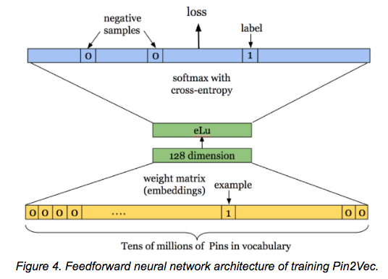
What we built
Unsupervised Neural Network
Produces meaningful numeric representations of diagnoses
Notes:
S

Slide 14
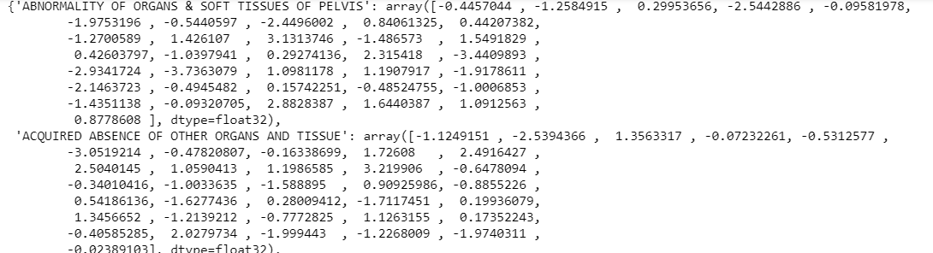
Embedding Output
*Show tensorflow embeddings projector
Notes:
S

Slide 15
How similar are these patients?
Jane Doe
Jack Doe
Larry Dav
Age:
64
Age:
55
Age:
12
DX:
DX:
DX:
Notes:
R
Ages are both present so it is easy → No feature engineering is needed
Both have a form of diabetes → but they aren’t exactly the same
Both have kidney issues, but they are different issues

Slide 16

Feature Engineering Deliverable
WHAT
Constructed software package that generated 36-dimensional diagnoses embeddings for use in ML models
Notes:
S
Also good for visualization
Spent most time on this

Slide 17
Model Construction
DATA PREPROCESSING
FEATURE ENGINEERING
MODEL CONSTRUCTION
COMMUNICATION
Notes:
R
This is the stuff that sounds cool and makes people go ooohhh ahhh, but the hard stuff is what comes before

Slide 18

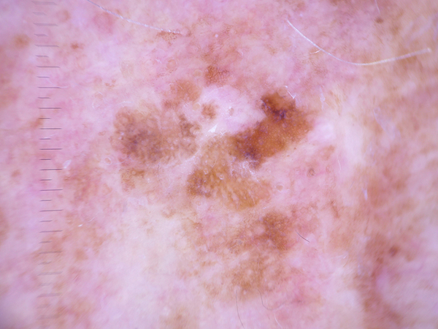
Skin Cancer Classification
WHY→ Given patient lesion images taken with a dermatoscope, classify skin cancer into Melanocytic nevi, Melanoma, Benign keratosis-like lesions , Basal cell carcinoma, Actinic keratoses, Vascular lesions, or Dermatofibroma
OUR MODEL→ Deep Convolutional Network with Image Augmentation
Notes:
R

Slide 19
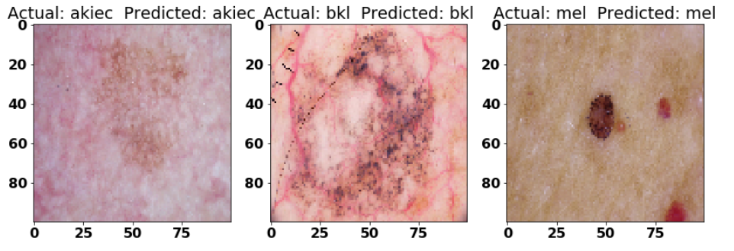
84% Accuracy
Here are a few prediction examples…
Notes:
R

Slide 20
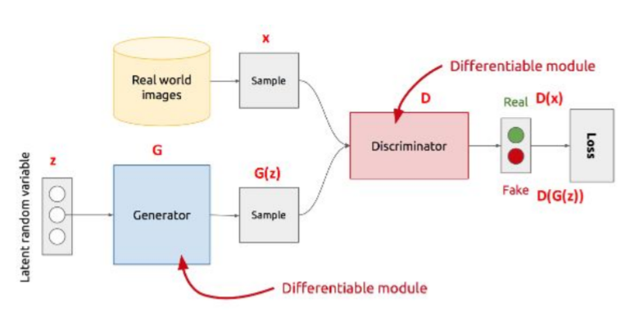
Diabetes GAN
WHY→ Given patient vitals, labs, and diagnosis embeddings, predict Patient Weights With and Without Diabetes
OUR MODEL→ Generative Adversarial Network (GAN)
Real Patient Weights
Notes:
S

Slide 21
Communication
DATA PREPROCESSING
FEATURE ENGINEERING
MODEL CONSTRUCTION
COMMUNICATION
Notes:
R

Slide 22
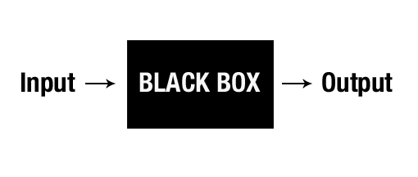
Communication
WHY:
Communication with the stakeholders
INTERPRETABLE models are essential
Physicians AI understanding helps project success
Notes:
S

Slide 23
Physician Wiki for Artificial Intelligence
SOLUTION:
An educational “Wikipedia-esque” guide for physicians that discusses critical aspects of AI in Healthcare
HOW:
Basic overview over AI vs ML vs Big Data
Emphasized the “AI WILL NOT TAKE OVER YOUR JOB”
Tool not Takeover
Hype vs Reality
Don’t read Forbes articles...
Discussion of current trends/impact of AI in healthcare
Split up by speciality (Radiology, Dermatology, etc)
Links to educational resources
Notes:
R

Slide 24
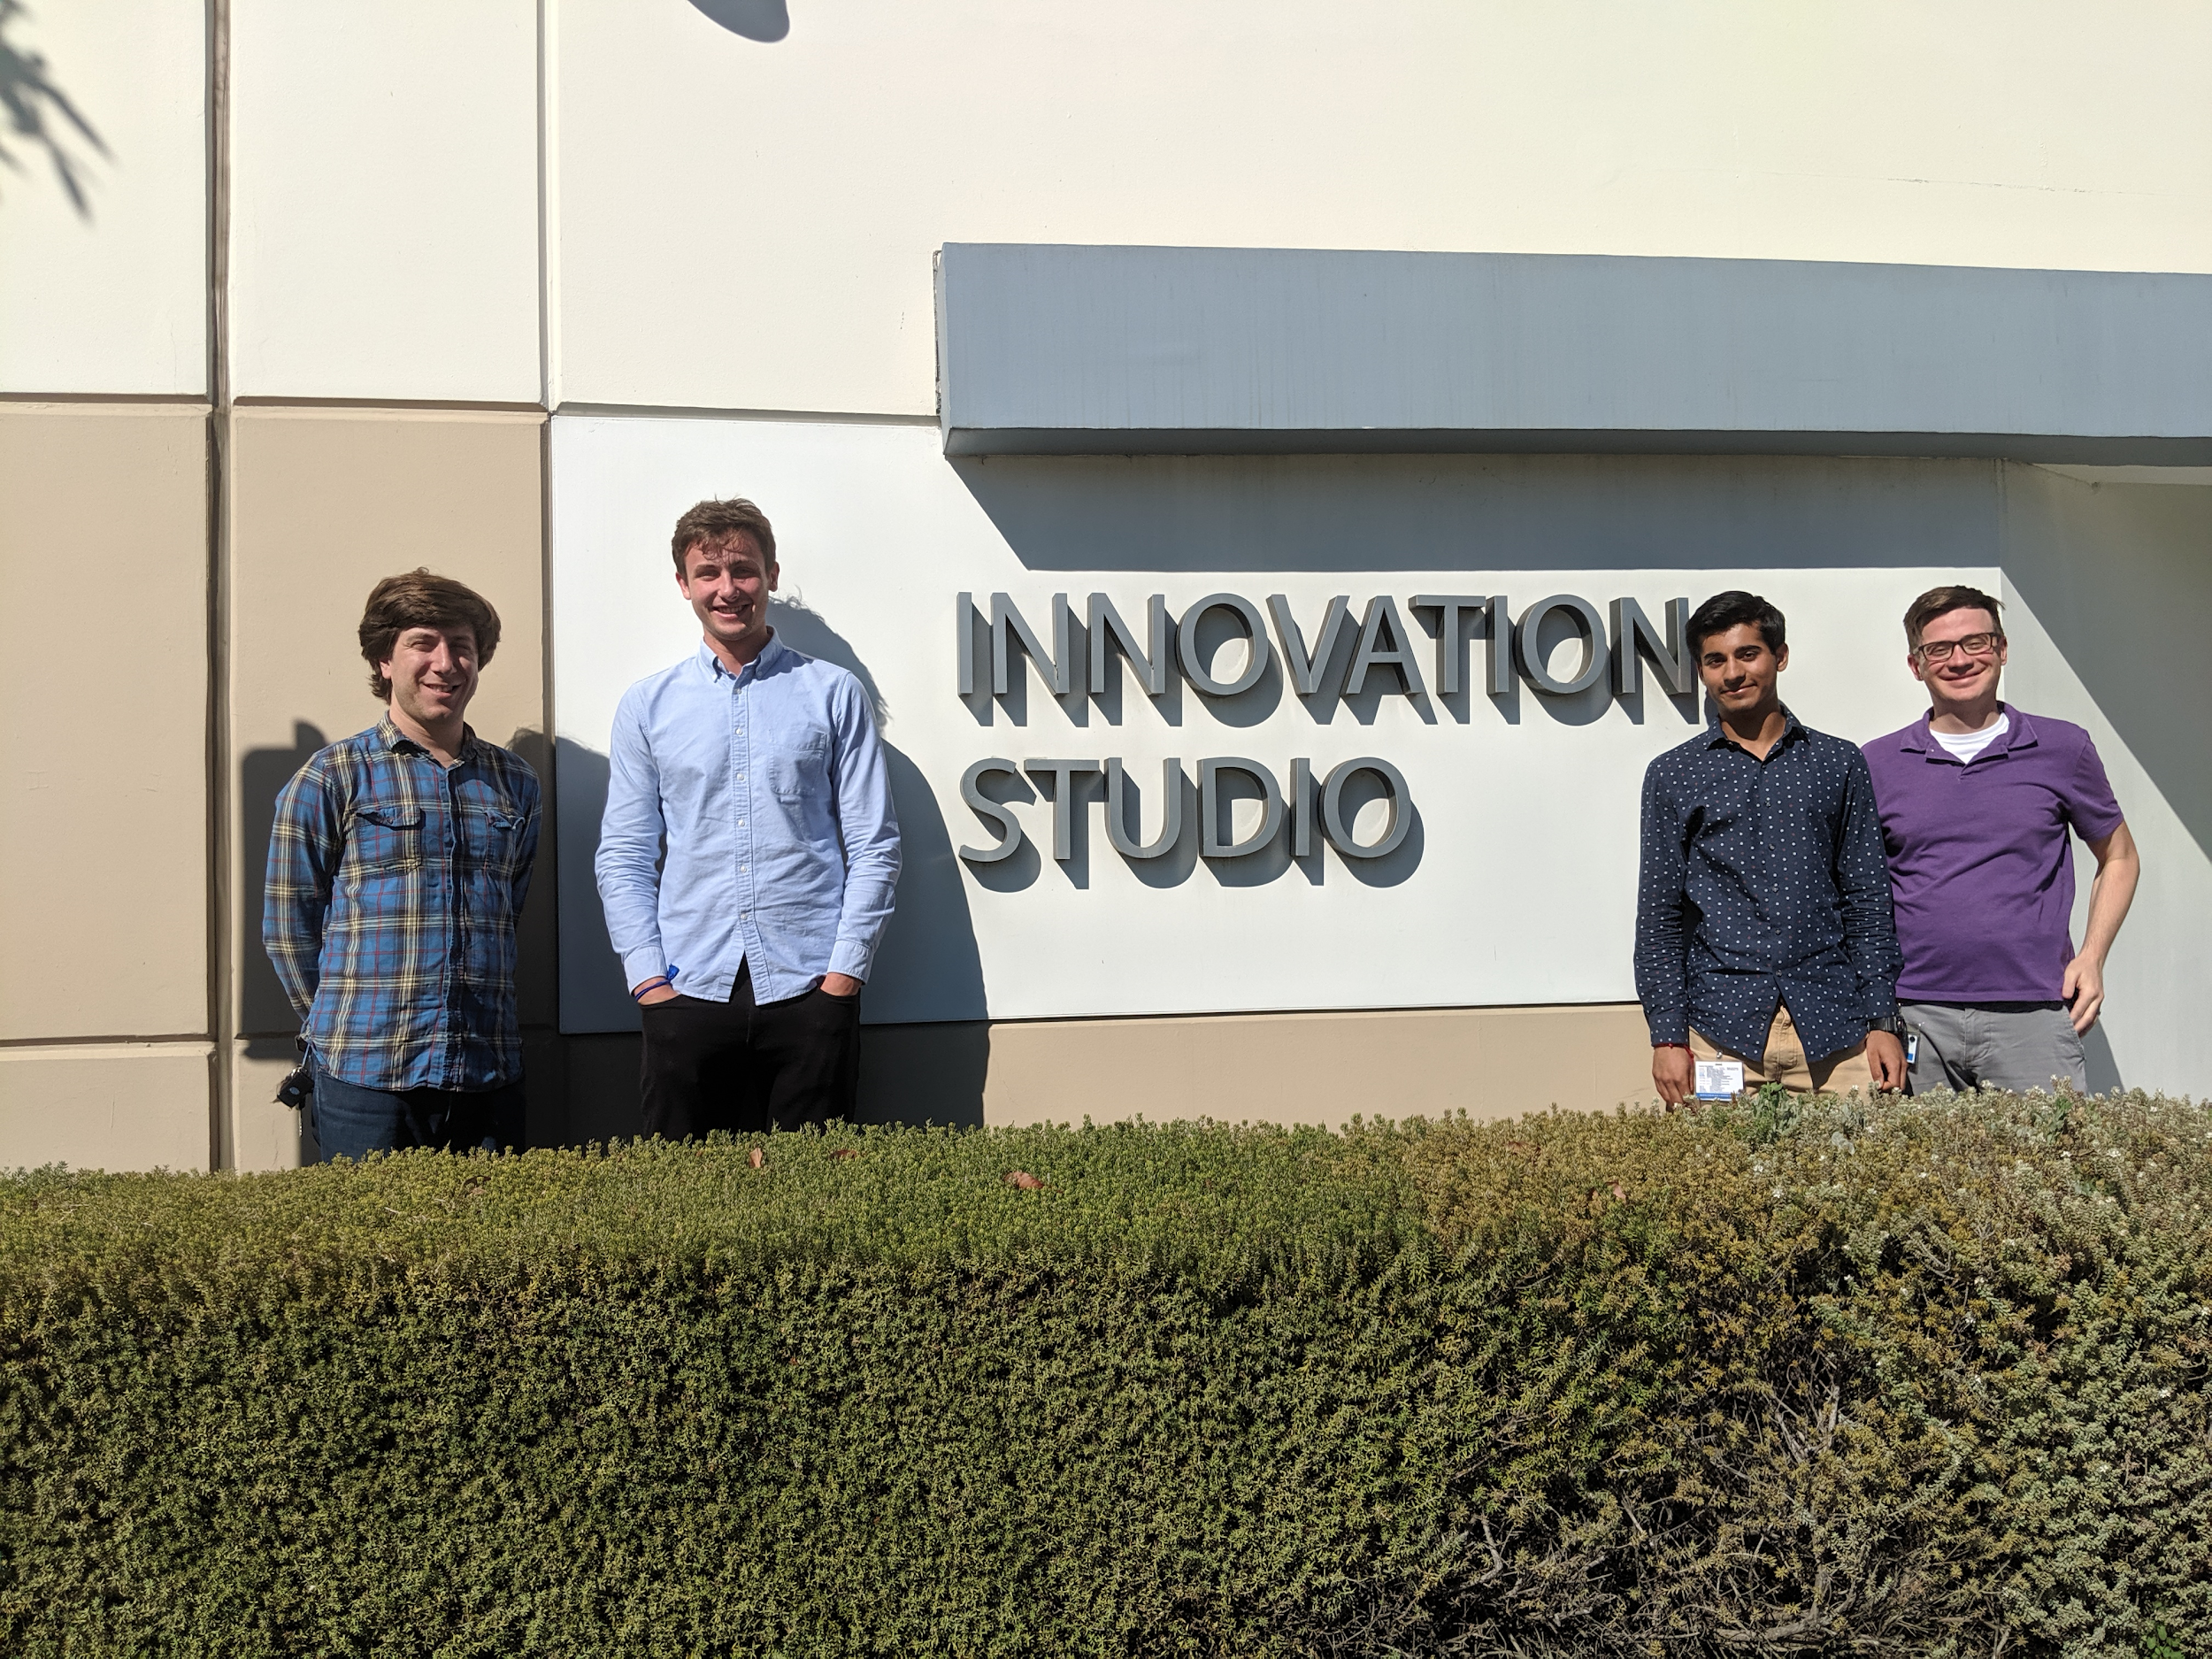
Thank You!
Notes:
S+R

